Slide 1
Azure Policy
Deep Dive with Brian O’Neil
brian@netadmin.com

Slide 2
Course Overview
Azure Policy Overview
Policy Deployment Lab
Anatomy of a Policy
Policy Aliases
Policy monitoring and logging
Where to get help

Slide 3
Assumptions
Knowledge of:
Azure Objects – Subscriptions, Management\Resource Groups, Resources
Familiarity with Azure CLI
Familiarity with Visual Studio Code
Participants have access to a valid Azure subscription (can be shared)

Slide 4
Azure Policy Overview

Slide 5
Overview
Management Groups
Azure Policy
Implementing Azure Policy
Policy Definitions
Initiative Definitions
Compliance

Slide 6
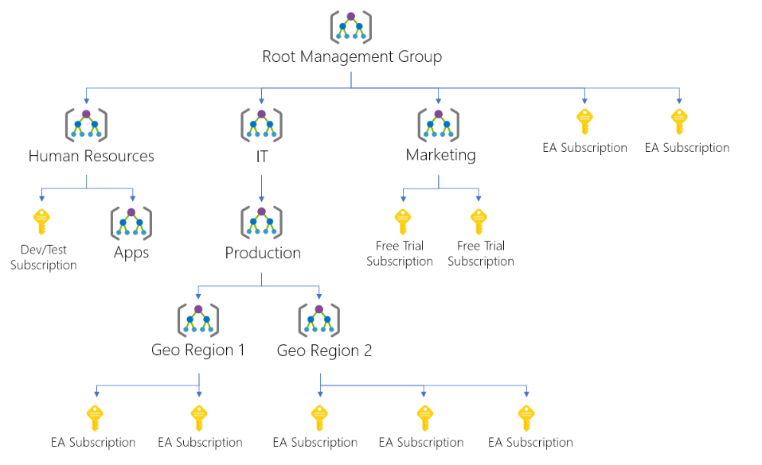
Management Groups
Provides a level of scope above subscriptions
Targeting of policies and spend budgets across subscriptions and inheritance down the hierarchies
Compliance and cost reporting by organization (business/teams)
Notes:
Create management groups for resource organization and management - https://docs.microsoft.com/en-us/azure/governance/management-groups/create
Manage your resources with management groups - https://docs.microsoft.com/en-us/azure/governance/management-groups/manage

Slide 7
Azure Policy
Azure Policy is a service in Azure that you use to create, assign and, manage policies
Azure Policy runs evaluations and scans for non-compliant resources
Advantages:
Enforcement and compliance
Apply policies at scale
Remediation
Notes:
https://docs.microsoft.com/en-us/azure/governance/policy/overview

Slide 8
Azure Policy Use Cases
Allowed resource types – Specify the resource types that your organization can deploy
Allowed virtual machine SKUs – Specify a set of virtual machine SKUs that your organization can deploy
Allowed locations – Restrict the locations your organization can specify when deploying resources
Require tag and its value – Enforces a required tag and its value
Azure Backup should be enabled for Virtual Machines – Audit if Azure Backup service is enabled for all Virtual machines
Notes:
https://docs.microsoft.com/en-us/azure/governance/policy/tutorials/create-and-manage
https://docs.microsoft.com/learn/modules/intro-to-governance/

Slide 9
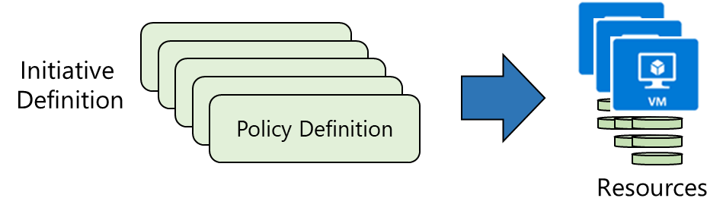
Implementing Azure Policy
Identify Policy Definition
Create Initiative Definitions
Scope Initiative Definition
View Policy evaluation results

Slide 10
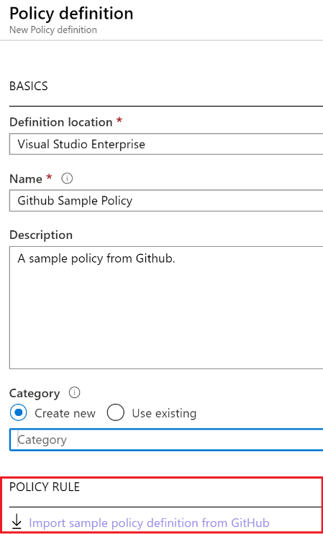
Policy Definitions
Azure and Github have pre-defined policy definitions
Specific JSON format
Built-in or Custom definitions
Notes:
https://docs.microsoft.com/en-us/azure/governance/policy/samples/built-in-policies

Slide 11
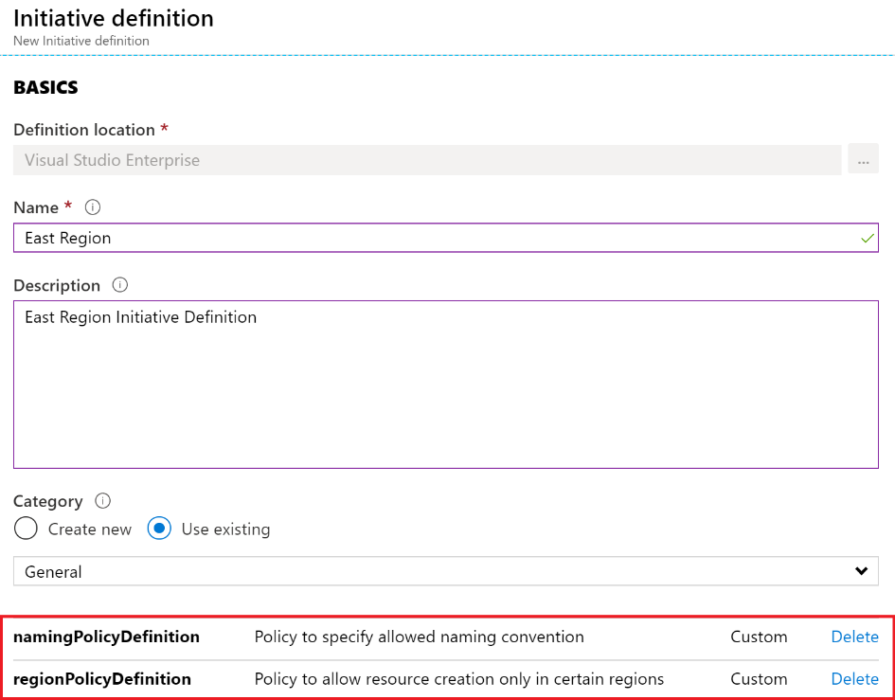
Create an Initiative Definition
Group Policy definitions together
One or more policies
Plan and test
Notes:
https://docs.microsoft.com/en-us/azure/governance/policy/samples/built-in-initiatives

Slide 12
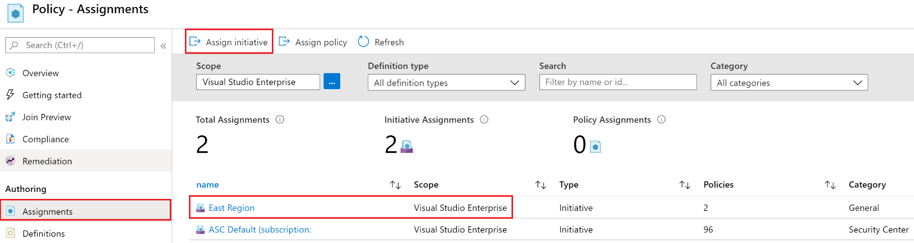
Scope the Initiative Definition
Assign the definition to a scope (Mgmt Group, Subscription, ResGrp)
Scope enforces policy to children

Slide 13
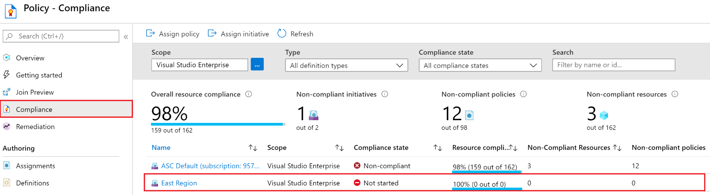
Determine Compliance
Non-compliant Initiatives, Policies and\or Resources
Force; az policy state trigger-scan --resource-group “<rg>”

Slide 14
Lab – Enforce Tags on Resources
CostCenter Tag must be on all individual resources
Prevent creation of resources without a CostCenter tag

Slide 15
Lab – Enforce Tags Policy – Create ResGrp
Open Azure Portal
Create an environmentally unique resource group under your permitted subscription either through UI or;
Bash
export RESOURCE_GROUP=PolicyDemoResGrp-$RANDOM
export LOCATION=westus
az group list --output table
az group list --query "[?name == '$RESOURCE_GROUP']"
az group create -l $LOCATION -n $RESOURCE_GROUP
Notes:
Policy - https://microsoftlearning.github.io/AZ-104-MicrosoftAzureAdministrator/Instructions/Labs/LAB_02b-Manage_Governance_via_Azure_Policy.html
CLI - https://docs.microsoft.com/en-us/learn/modules/control-azure-services-with-cli/5-exercise-create-website-using-the-cli

Slide 16
az policy definition create --name EnforceCostCenterTag --description "Enforce Cost Center Tag" --rules '{
"if": {
"allOf": [
{
"field": "tags['CostCenter']",
"exists": false
}
]
},
"then": {
"effect": "deny"
}
}'
az policy assignment create --policy EnforceCostCenterTag --resource-group $RESOURCE_GROUP

Slide 17
Policy – Azure CLI
az policy definition create –name <name> --description <description> --rules ‘{ <code>}’
if
then
effect
az policy definition list
az policy assignment create –policy <name> --resource-group <rg>
Notes:
https://docs.microsoft.com/en-us/azure/governance/policy/tutorials/create-and-manage#create-a-policy-definition-with-azure-cli

Slide 18
Anatomy of a Simple Policy
Properties
policyType – custom, built-in or static (ms managed)
Mode
Index or All
Index – only target items that support tags or locations, form of type checking
Metadata
PolicyRule
If\Then
ID
Type
Name
Notes:
https://docs.microsoft.com/en-us/azure/governance/policy/concepts/definition-structure

Slide 19
Lab – Create a web app from Azure CLI
export AZURE_APP_PLAN=popupappplan-$RANDOM
export AZURE_WEB_APP=popupwebapp-$RANDOM
az appservice plan create --name $AZURE_APP_PLAN --resource-group $RESOURCE_GROUP --location $LOCATION --sku FREE
az webapp create --name $AZURE_WEB_APP --resource-group $RESOURCE_GROUP --plan $AZURE_APP_PLAN
az appservice plan list --output table
az webapp list --output table
add the –tags
-- tags CostCenter=dev

Slide 20
Policy Parameters
Previous Example would result in too many policies to apply broadly
Parameters are used to define properties
Parameters are assigned during policy assignment
Supports “defaultValue”
Example
Find Policy “Require a tag and its value on resources”
Make note of ‘Tag Name’ and ‘Tag Value’ and the description for each
Assign this tag to your resource group
Unassign the policy from the previous lab
Notes:
https://docs.microsoft.com/en-us/azure/governance/policy/concepts/definition-structure

Slide 21
Force Evaluation Scan
CLI: az policy state trigger-scan --resource-group “<rg>”
Powershell: Start-AzPolicyCompianceScan -resourcegroupname “<rg>”

Slide 22
Parameters Example 2
"parameters": {
"allowedLocations": {
"type": "array",
"metadata": {
"description": "The list of allowed locations for resources.",
"displayName": "Allowed locations",
"strongType": "location"
},
"defaultValue": [ "westus2" ],
"allowedValues": [
"eastus2",
"westus2",
"westus"
]
}
}
Notes:
https://docs.microsoft.com/en-us/azure/governance/policy/concepts/definition-structure

Slide 23
Policy Rules - If
If – one or more conditions for the policy to be in force
“if “: {<condition>|<logical operator>}
Logical Operators
not - no condition must be true
allOf – all conditions must be true (AND)
anyOf – one or more condition must be true (OR)
Condition – used to validate field or value parameters
“exists”: “bool”
“exists”: “false”
Note in “require tag” policy, if none of the parameters have a value, the effect is deny
Notes:
https://docs.microsoft.com/en-us/azure/governance/policy/concepts/definition-structure

Slide 24
Policy Rules - Then
What happens when policy is triggered?
Effects
deny
audit
modify
append
auditIfNotExists - warning if resource does not exist
deployIfNotExists - deploys a resource if it doesn’t exist
disabled - does not evaluate policy
Notes:
https://docs.microsoft.com/en-us/azure/governance/policy/concepts/definition-structure

Slide 25
Conditions and Fields
Search in Azure Policy for ‘Disk encryption should be applied on virtual machines’
field: type
if the resources this policy is applied to equals this type
In:
resource types that are valid for this policy to be applied
Notes:
https://docs.microsoft.com/en-us/azure/governance/policy/samples/pattern-fields

Slide 26
Policy Extension for VS Code
Install and open VS Code, navigate to extensions marketplace
Search for ‘Azure Policy’, latest is v0.1.0 as of Oct 20, 2020
Select the policy extension and sign into your Azure account if prompted (will open a browser window)
Under Resources - expand the Resource Provider folder and allow VS Code to take time to expand the list (az provider show)
VS Code will allow you to edit and save local, but currently does not support saving policy directly to Azure
Notes:
https://docs.microsoft.com/en-us/azure/governance/policy/how-to/extension-for-vscode

Slide 27
Azure Resource Providers
A Resource Provider provides the properties available to a given resource within the context of a subscription
A provider set is also called a Name Space
Each item in a Name Space is called a resourceType
Microsoft.Compute/availabilitySets
API version validity is expressed in each resourceType
Azure Portal: Resource Explorer
CLI: az provider show --namespace Microsoft.Storage
VS Code: Azure Policy extension

Slide 28
Resource Manager Aliases
Resource Providers and Aliases are part of the Resource Manager subsystem in Azure
Policies are also part of the Resource Manager subsystem
Policies use Resource Providers and aliases to assemble conditions during policy instantiation and assignment
az provider show --namespace Microsoft.Storage --expand "resourceTypes/aliases" --query "resourceTypes[].aliases[].name"
Notes:
https://azure.microsoft.com/en-us/blog/more-resource-policy-aliases/
https://docs.microsoft.com/en-us/azure/governance/policy/tutorials/create-custom-policy-definition

Slide 29
Find Modifiable Aliases
Get-AzPolicyAlias -NameSpace Microsoft.Storage | Select-Object -ExpandProperty 'Aliases' | Where-Object { $_.DefaultMetadata.Attributes -eq 'Modifiable' }

Slide 30
Check if an NSG is empty
{
"count": {
"field": "Microsoft.Network/networkSecurityGroups/securityRules[*]"
},
"equals": 0
}
Notes:
https://docs.microsoft.com/en-us/azure/governance/policy/concepts/definition-structure#aliases

Slide 31
Lab - VS Code Policy Evaluation
Create a VM resource in your azure account
Pin the VM resource and the “Disk encryption should be applied on virtual machines” policy to the evaluation pane in VS code
Run the policy evaluation and observe the results in the window output labeled untitled

Slide 32
More Help
Azure Policy documentation
https://docs.microsoft.com/en-us/azure/governance/policy/
Azure Policy Definition Structure
https://docs.microsoft.com/en-us/azure/governance/policy/concepts/definition-structure#aliases
Azure Policy Git Repo
https://github.com/Azure/azure-policy
Azure Learn
https://docs.microsoft.com/en-us/learn/browse/

Slide 33
Time Permitting - Lab
As a class, define a policy use case that has value to the business
Implement the use case in policy and apply it to the available resources
Use the tools and techniques from this class to develop, test and then evaluate the success of this policy

